Slide 1
Activity Recognition using Text Mining and Object Recognition
Niranjan A. Viladkar
Under the guidance from
Dr. Subhashis Banerjee and Dr. Parag Singla
Department of Computer Science
IIT Delhi
M.Tech Minor Project Presentation – May 13, 2013

Slide 2
Problem Statement
What is Video Activity Recognition?

Slide 3
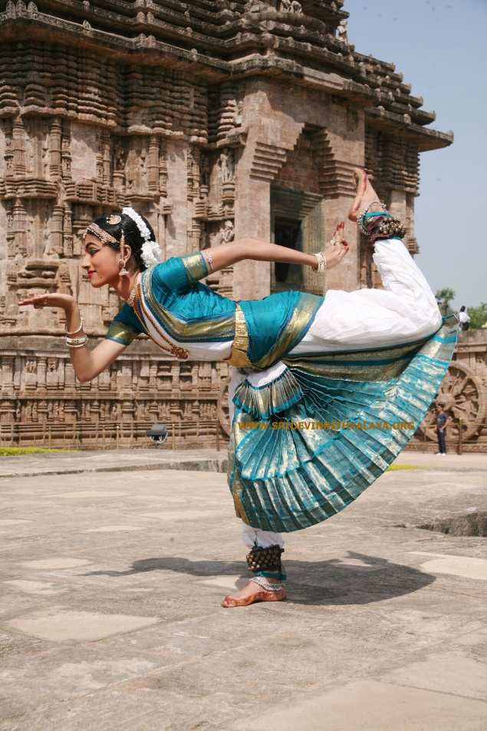
Problem Statement
What is Video Activity Recognition?
Dance

Slide 4
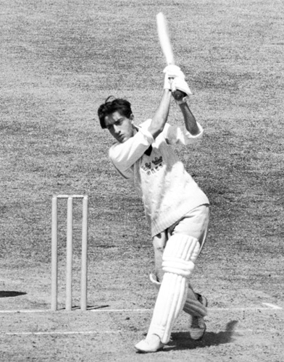
Problem Statement
What is Video Activity Recognition?
Play

Slide 5
Approach
Improving Video Activity Recognition using Object Recognition and Text Mining
by Tanvi Motwani and Raymond J. Mooney, ECAI-2012

Slide 6
Approach – Only Text Mining
Extract Labels - Use Natural Language descriptions of video clips.
Extract STIP features – Represent a clip in HoG and HoF features.
Train a model

Slide 7
Approach – Only Text Mining
Natural Language Description of a video

Slide 8
Approach – Only Text Mining
Natural Language Description of a video
Batsman is playing cricket

Slide 9
Approach – Only Text Mining
Natural Language Description of a video
Batsman is playing cricket
Mansoor Ali Khan Pataudi is playing cricket.

Slide 10
Approach – Only Text Mining
Natural Language Description of a video
Batsman is playing cricket
Mansoor Ali Khan Pataudi is playing cricket.
Players are playing cricket.

Slide 11
Approach – Only Text Mining
Extracting Verbs from Description
Batsman is playing cricket : PLAY
Mansoor Ali Khan Pataudi is playing cricket. : PLAY
Players are playing cricket. : PLAY

Slide 12
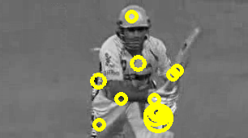
Approach – Only Text Mining
Extracting STIP features
STIP HoG and HoF feature vector :
0.627496 0.0892087 0.0293946 0.253901 0.668772 0.160494 0.000758835 0.169975 0.414533 0.508073 …
…...
…...

Slide 13
Approach – Only Text Mining
Take random samples of STIP feature descriptors
Clustering K-Means
Describe a video clip in terms of these clusters

Slide 14
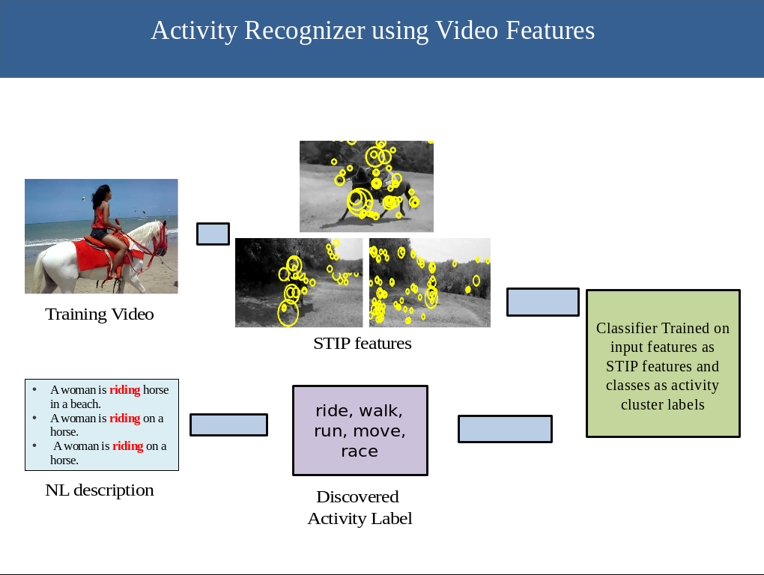

Slide 15
Object Detection
Using Discriminatively Trained Deformable Part Models
  Pre-trained object detector for 19 objects

Slide 16
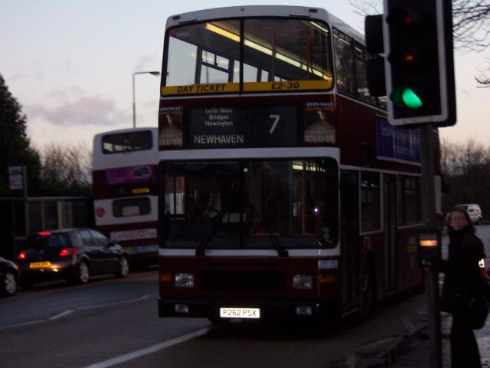
Object Detection

Slide 17
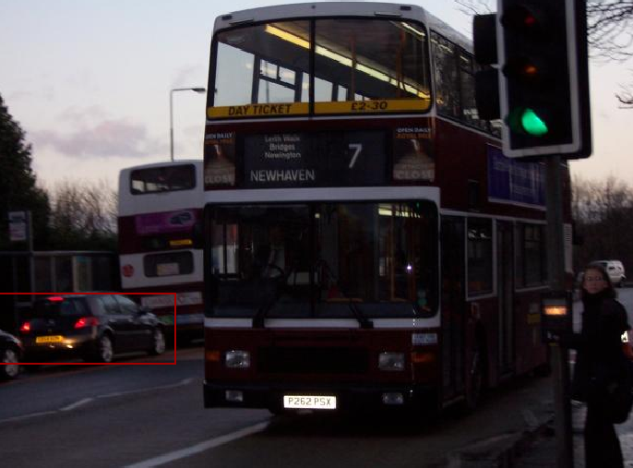
Object Detection

Slide 18
Relation between Activity and Objects
English Gigaword Corpus – 15 GB of raw text
Occurrence counts:
  of an activity A_{i}: occurrence of the verbs
  of an object O_{j}: occurrence of object noun O_{j} or its synonym.
Co-occurrence of an Activity and an Object:
  POS Tagging
    Using Stanford tagger.
    Occurrence of the object ( tagged as noun ) within a window of w or fewer words of an occurrence of the activity ( tagged as verb ).

Slide 19
Relation between Activity and Objects
Probability of each activity given each object

Slide 20
Integrated Activity Recogniser
P(A_{i} | F_{v}) – Calculated in 1st part.

Slide 21
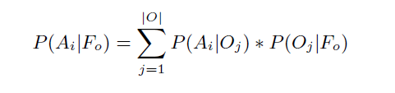
Integrated Activity Recogniser
P(A_{i} | F_{v}) – Calculated in 1st part.
P( A_{i} | F_{o} ) -
Gigaword Corpus
Object Detector

Slide 22
Integrated Activity Recogniser
P(A_{i} | F_{v}) – Calculated in 1st part.
P( A_{i} | F_{o} ) -
Consider only P ( A_{i} | F_{v} ) when no object is detected and P ( A_{i} | F_{o} , F_{v} ) when objects are recognized

Slide 23
Work Done
Verbs Extraction from Natural language description of clips done.
Clip Name | Natural Language Description
_0nX-El-ySo_83_93 | A man is cutting a piece of paper.
_0nX-El-ySo_83_93 | A man is cutting a paper by scissor.
_0nX-El-ySo_83_93 | A man is cutting paper.
_0nX-El-ySo_83_93 | A man is cutting a piece of paper.

Slide 24
Work Done
Verbs Extraction from Natural language description of clips done.
Clip Name | Most frequent verb identified
_0nX-El-ySo_83_93 | cut
_1vy2HIN60A_32_40 | jump
_6OTzzK7t9Y_158_170 | play
_6OTzzK7t9Y_73_78 | crash

Slide 25
Work Done
Classes Extraction from Natural language description of clips done.
Clip Name | Most frequent verb identified
_0nX-El-ySo_83_93 | cut, slice
_O9kWD8nuRU_70_76 | peel, remove
_JVxurtGIhI_32_42 | sing, talk, bark
_WRC7HXBJpU_414_425 | pour, stir, put

Slide 26
Work Done
Classes Extraction from Natural language description of clips done.
STIP features extraction done.

Slide 27
Work Done
Classes Extraction from Natural language description of clips done.
STIP features extraction done.
Clustering done.

Slide 28
Work Done
Classes Extraction from Natural language description of clips done.
STIP features extraction done.
Clustering done.
Work To be Done
Representation of each clip
Learning a model

Slide 29
Work Done
Classes Extraction from Natural language description of clips done.
STIP features extraction done.
Clustering done.
Work To be Done
Representation of each clip
Learning a model
Object Detection
Learning Gigaword Corpus

Slide 30
Novel Idea
Approach by Motwani et al. is only in forward direction.
We plan to introduce notion of feedback
  To improve accuracy of weak object detector and activity recogniser

Slide 31
References
Improving Video Activity Recognition using Object Recognition and Text Mining by Tanvi Motwani and Raymond J. Mooney, ECAI-2012
WordNet – 3.0 from Princeton University
MIT Java Wordnet Interface from MIT
WordNet Similarity from Sussex university

